Slide 1
Research and Ideation Presentation
Aarnav Devulapalli

Slide 2

Current App Overview
The current app has a ton of links to other websites. Could potentially be fixed by calling the APIs and keeping the info from opening other links.
Not many students I talked to used or downloaded app
Of those who do many use it as a middle-man to allow access to other apps
Could benefit from its own functionality that would increase usage

Slide 3

TestudoChat (Favorite)
GPT-3 LLM for custom chatbot in Modo App
Can help replace menial questions for advisors and minimize student effort
5 Friends say this would definitely make them use the app
Current plan is to use multiple lambda expressions to allow for implementation or build my own API and host the code on a server.
Chatbot Demo

Slide 4
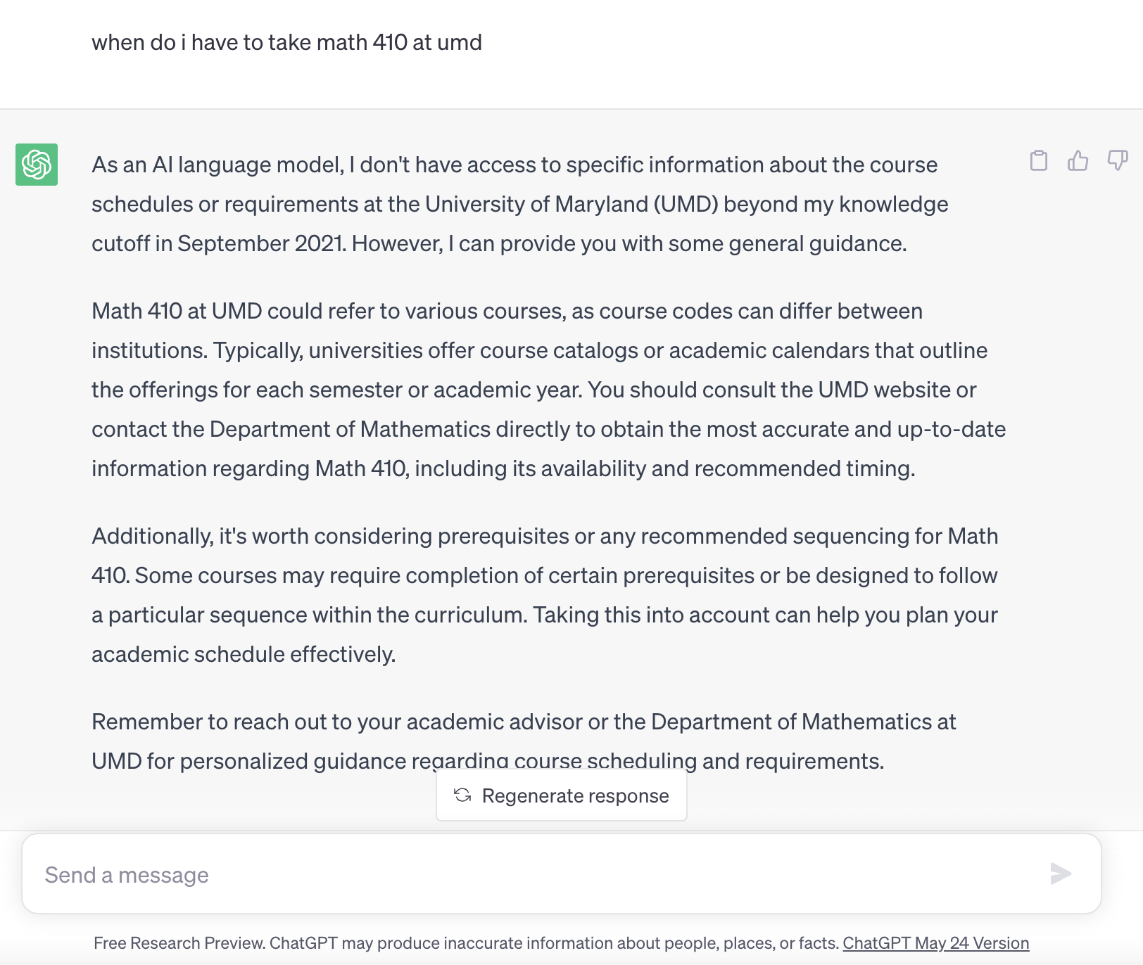
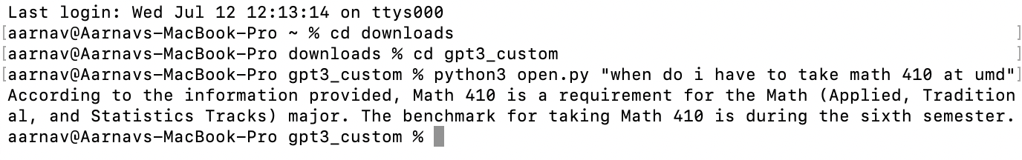
Demo (if I cannot share screen)

Slide 5
Business Side and Implementation
Can allow businesses to auto train their own bot.
The implementation would depend on if I only make it for the UMD app or also include the business facing side or could talk to somebody to help implement the business facing side.
Example: Capital one could train their bot on careers link then could allow users for app to see specific information. Since we mainly make business and company apps you could link jobs and could input resume into chatbot to find one that matches well.
Trainer Demo

Slide 6
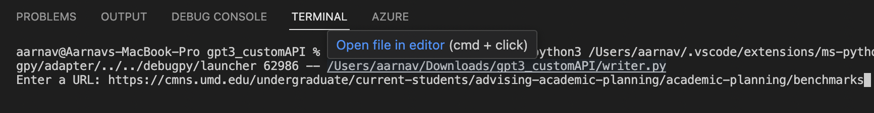
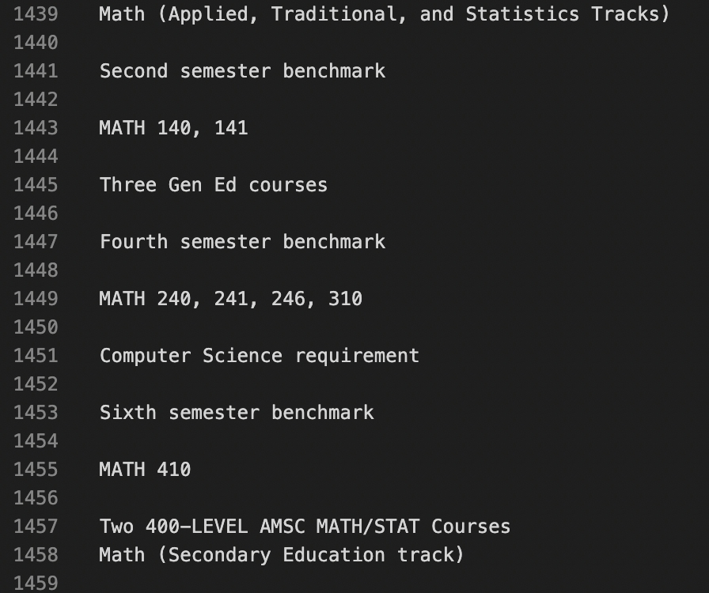
Trainer Demo
Insert Link
Trained file

Slide 7

Tutoring Portal
Tutoring service where people can join as tutors for particular classes and others can find tutors for subjects and can negotiate their own prices or post prices on their description.
Implement using list and when you click element either opens a chat or shows preferred contact info (easier to just show information).

Slide 8
Other Ideas
Mental wellness portal with access to multiple links and videos. Could be implemented using what we learned from xmodule course.
Use of satellite data to try and add possible blocks from construction or other to the umd map on google for walking so you know what routes to take.
LinkedIn integration so you can connect with other umd students. Logs these users in app and recommends them to each other.
Nearby living options, can find all nearby dorm options and prices for college apps. Use google maps API to find living and can web scrape to find monetary data then display a table and allow users to sort by prices.

Slide 9

Idea Summary
Chatbot (Prototype)
Tutoring (Prototype)
Wellness Portal
Satellite Data
Linkedin Connection Recommendations
Housing finder

